Slide 1
SQL – joins

Slide 2
JOINS
The SQL Joins clause is used to combine records from two or more tables in a database.
A JOIN is a means for combining fields from two tables by using values common to each.
TYPES:
Inner Join
Left Outer Join
Right Outer Join
Full Outer Join
Self Join
Cartesian Join

Slide 3
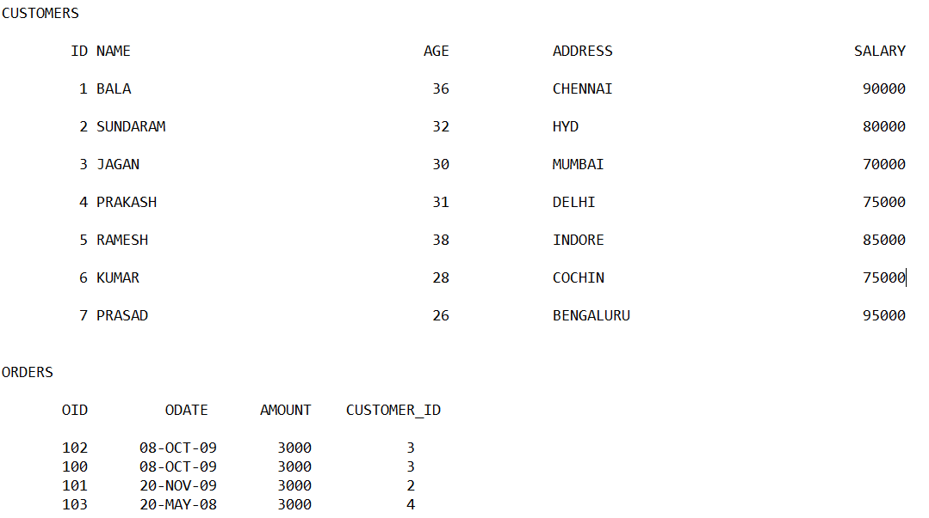
JOINS

Slide 4
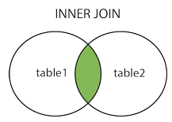
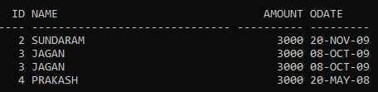
INNER JOIN
The INNER JOIN keyword selects records that have matching values in both tables.
SELECT ID, NAME, AMOUNT, ODATE
FROM CUSTOMERS
INNER JOIN ORDERS
ON CUSTOMERS.ID = ORDERS.CUSTOMER_ID;

Slide 5
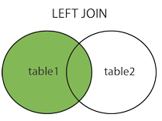
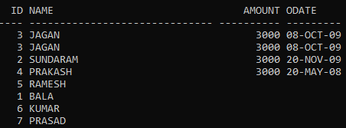
LEFT OUTER JOIN
Returns all records from the left table, and the matched records from the right table.
SELECT ID, NAME, AMOUNT, ODATE
FROM CUSTOMERS
LEFT JOIN ORDERS
ON CUSTOMERS.ID = ORDERS.CUSTOMER_ID;

Slide 6
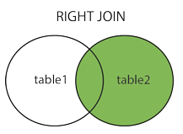
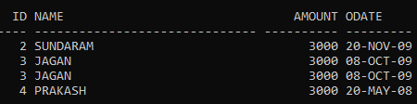
RIGHT OUTER JOIN
Returns all records from the right table, and the matched records from the left table.
SELECT ID, NAME, AMOUNT, ODATE
FROM CUSTOMERS
RIGHT JOIN ORDERS
ON CUSTOMERS.ID = ORDERS.CUSTOMER_ID;

Slide 7
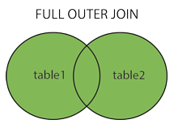
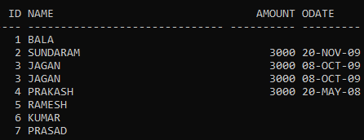
FULL OUTER JOIN
Returns all records when there is a match in either left or right table.
SELECT ID, NAME, AMOUNT, ODATE
FROM CUSTOMERS
FULL JOIN ORDERS
ON CUSTOMERS.ID = ORDERS.CUSTOMER_ID;

Slide 8
SELF JOIN
Join a table to itself as if the table were two tables
SELECT a.ID, b.NAME, a.SALARY
FROM CUSTOMERS a, CUSTOMERS b
WHERE a.SALARY < b.SALARY;

Slide 9
CARTESIAN JOIN
The CARTESIAN JOIN or CROSS JOIN returns the Cartesian product of the sets of records from two or more joined tables.
SELECT ID, NAME, AMOUNT, ODATE
FROM CUSTOMERS, ORDERS;

